Slide 1
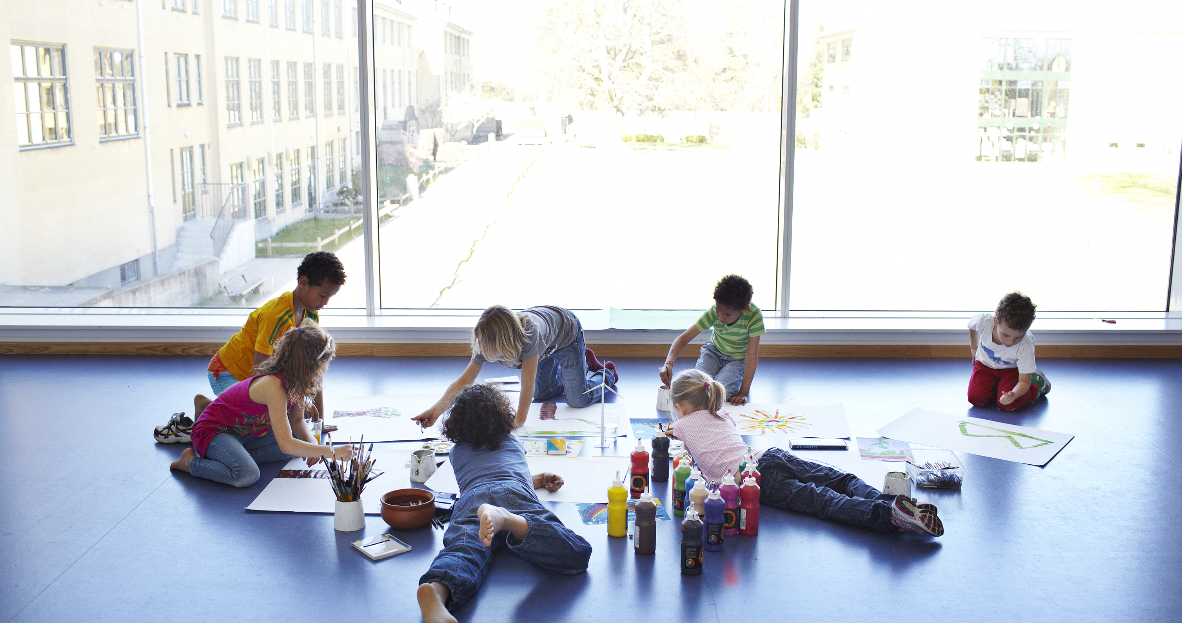
Inner Strength Programme: Empowering Danish Youth A pitch deck for investors

Slide 2
Inner Strengh Programme
An innovative initiative by the Human Practice Foundation.
Addressing the growing mental dissatisfaction among Danish youth.
Fostering resilience, confidence, and balance for a brighter future."

Slide 3
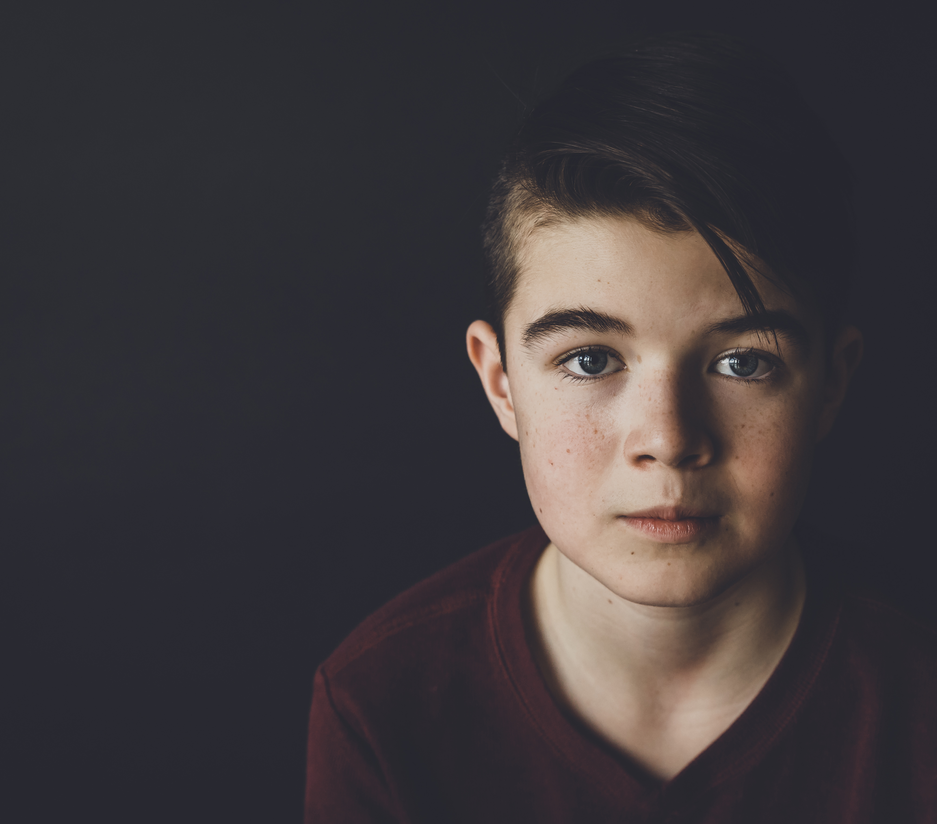

The problem: Rising Mental Dissatisfaction
Sharp increase in stress, anxiety, and feelings of inadequacy among Danish youth.
Driven by societal pressures and recent global crises, like COVID-19.
Impacting mental, academic, and social well-being."

Slide 4
Our mission: Holistic empowerment for youth
Goals
Build self-worth and self-confidence.
Enhance focus and academic engagement.
Strengthen relationships in and out of school.
Our approach:
Develop children’s self-worth, focus, and social inclusion.
Train teachers in relational competencies and self-awareness.
Inspire parents to support their children’s growth.
Foster positive school culture through inclusive strategies.

Slide 5
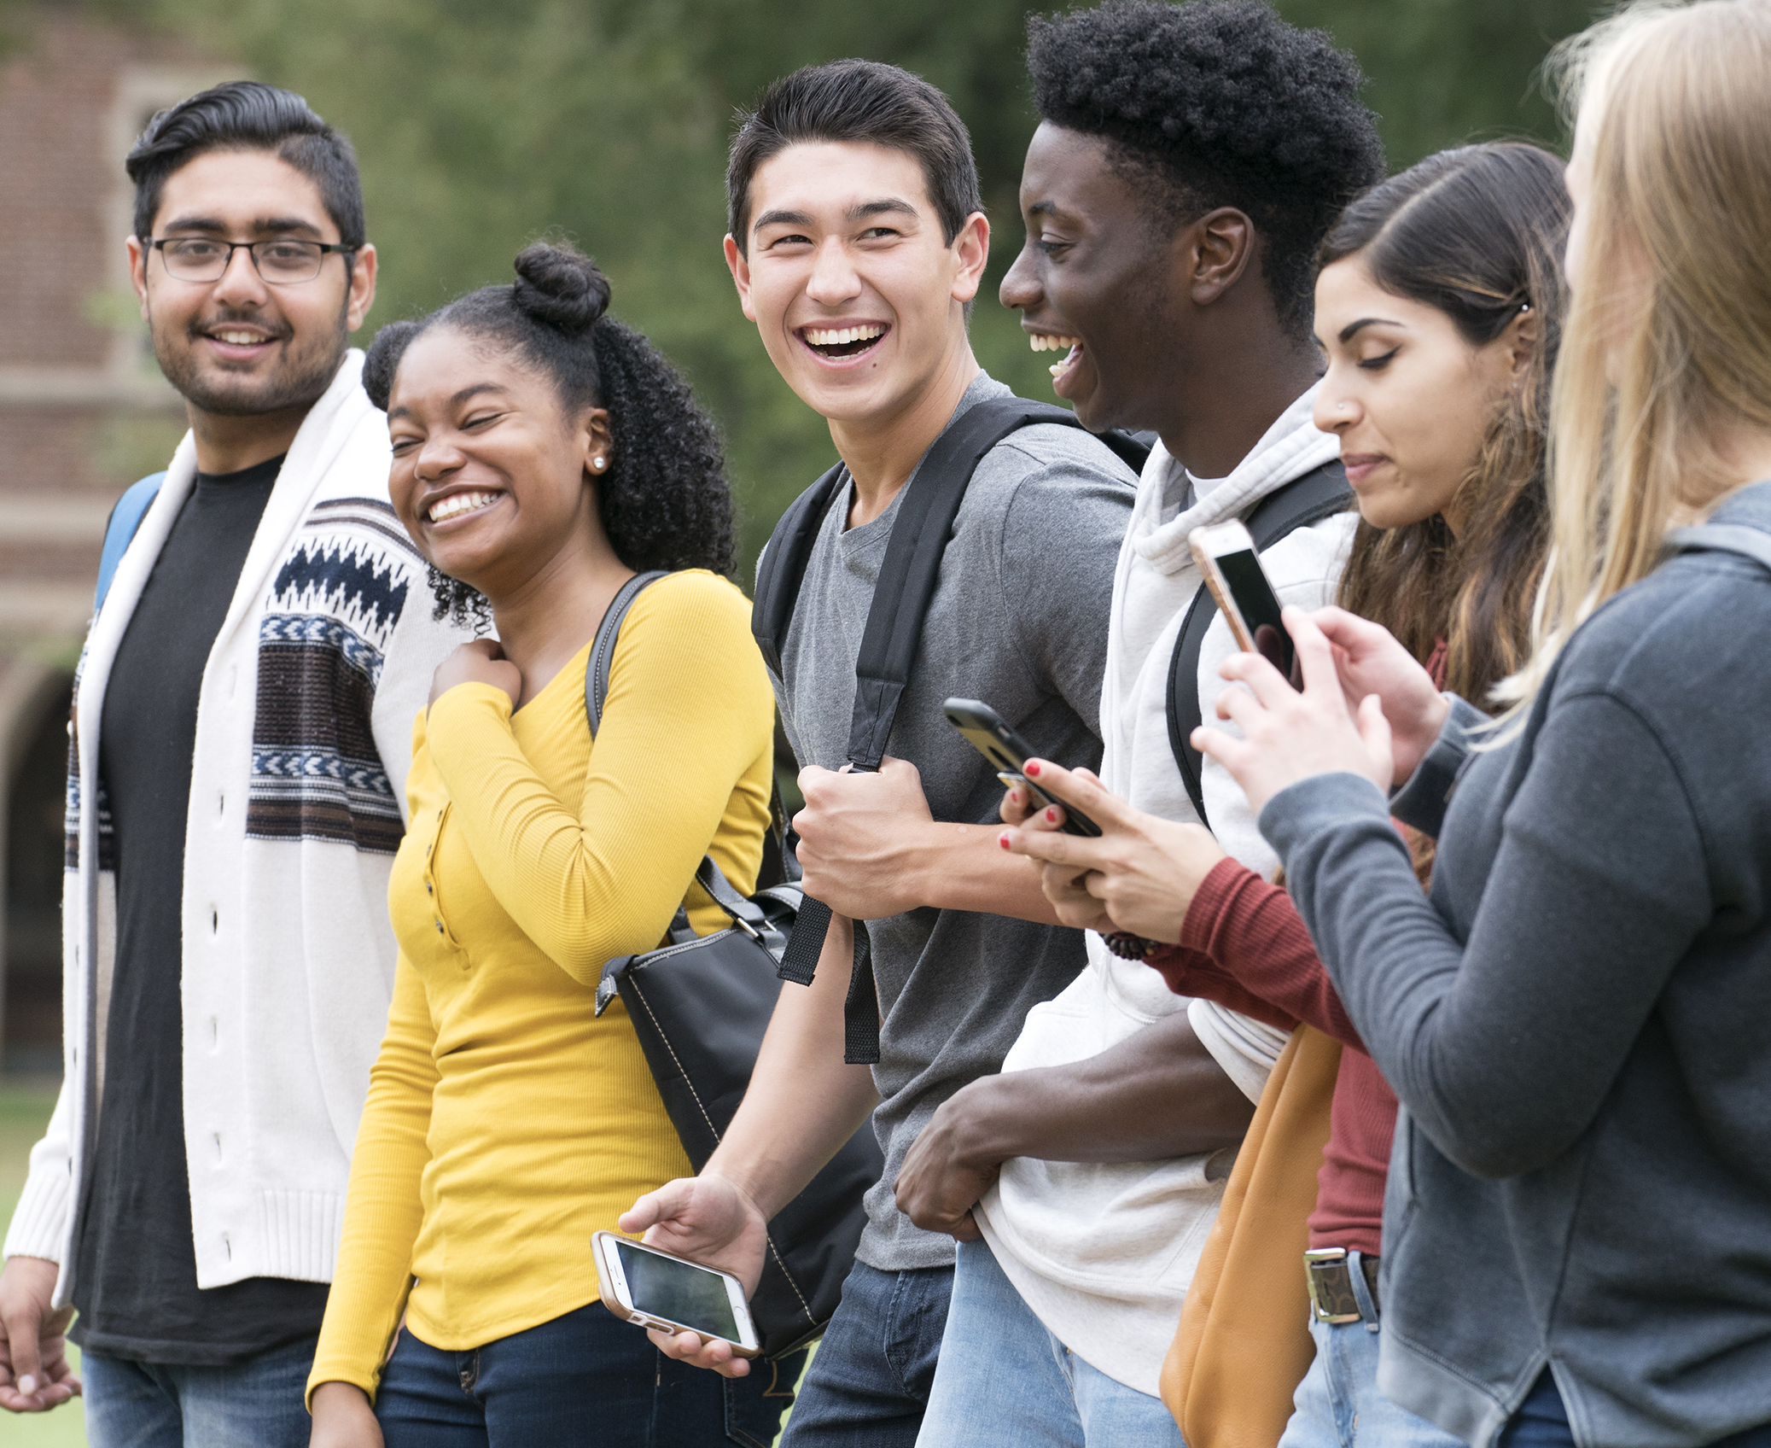
Real impact: Transforming lives
Since 2022, over 3,500 students across 16 schools have benefitted.
Pilot projects report significant improvements in self-worth, focus, and engagement.
Testimonials: Educators and parents praise the programme's transformative effect.
Endorsement: Supported by A.P. Møller Foundation with a grant of DKK 15 million."

Slide 6

Join us in making a difference
The Next Step: A digital learning platform to scale the Inner Strength Programme.
Your Impact: Help us empower thousands more students.
Request: A donation of DKK 200,000 to make this vision a reality.
Together, we can build a stronger, more resilient future for Danish youth."

Slide 7
Thank you
Human Practice Foundation
+45 93 93 27 74
www.humanpractice.org

